Slide 1
Ecommerce Website Using Odoo
Group-3

Slide 2
Group Members
UIT- 1229 Khine Zin Nyunt
UIT- 1242 Paing Zay Khant
UIT- 1084 Htet Arkar Oo
UIT- 1184 Myo Thein Chit
UIT- 1286 May Shune Lae Naing
UIT- 1216 Yell Swann Yee

Slide 3
Introduction
We will discuss about e-commerce system of odoo with a furniture online store.
khinezinnyunt2.odoo.com

Slide 4

ERP MODULES used in our shop
Product management
Order processing
Payment and shipping
Inventory management

Slide 5

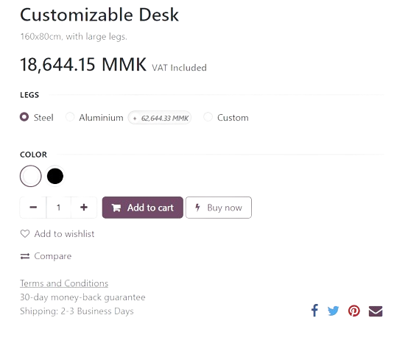
Product Configurations
Product catalog:
Product name
Product variants (eg. size,colour, material)
Price
Categories
Add to cart or buy now
Stock quantity
Compare function

Slide 6


Order Processing
Adding Products to Cart
Once customers decide on their purchases, they add the selected products to their shopping cart. They can adjust quantities, apply discounts or promotions, and review their selections before proceeding to checkout.
Checkout Process
Customers proceed to the checkout process to complete their purchases. We provide shipping and billing information, select shipping methods, and choose payment options and also pick up date.

Slide 7

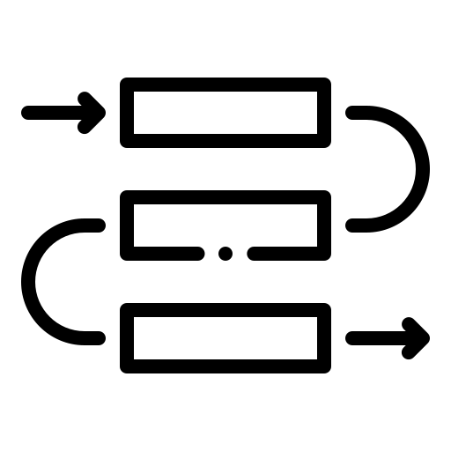
Order Processing
Order Confirmation
After completing the checkout process, customers receive an order confirmation email with details of their purchase, including order number, items ordered, total amount, shipping address, and estimated delivery date.
Order Processing
Orders are automatically created and processed in the backend as soon as customers complete the checkout process on the website. The order details are captured in the Odoo system, including customer information, products ordered, quantities, prices, and payment status.

Slide 8


Order Processing
Invoicing and Payment
Odoo generates invoices for completed orders, which can be sent to customers electronically or included with the shipped products. Customers can make payments online using the chosen payment method, and Odoo records payment transactions against the corresponding orders.
Customer Communication and Analytics
Throughout the order processing lifecycle, Odoo facilitates communication with customers by sending automated notifications and updates via email or SMS. Users can view order histories, track sales performance, and generate reports to gain insights into customer behavior, product trends, and revenue metrics.

Slide 9

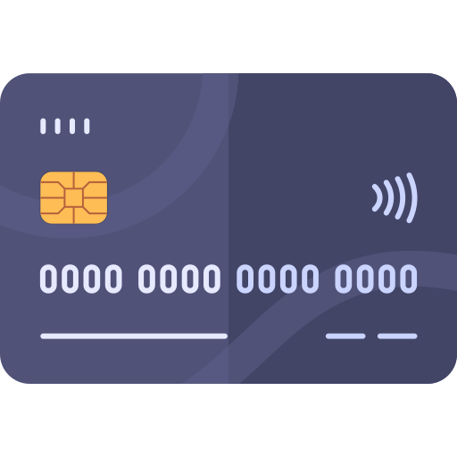


Payment options and Providers
Administrators can set up various payment methods to offer customers flexibility in how they pay for their purchases. Common payment methods include e-wallets, credit/debit cards, PayPal, bank transfers, and cash on delivery.
PayPal
Credit/Debit cards
Bank
Cash On Delivery

Slide 10
Shipping
Shipping methods
Pick up in store
Own shipping
Shipping providers
Shipping rate
Based on the selected shipping method, destination address, package weight and other relevant factors

Slide 11
Shipping Label Generation
Once orders are confirmed, Odoo provides tools to generate shipping labels and packing slips for outgoing shipments. Shipping labels include shipping details, carrier information, tracking numbers, and barcodes for easy identification and tracking.
Invoice and legal requirements
The final step of an ecommerce order is to generate the invoice and send it to the customer. Depending on the type of business (B2B or B2C), an invoice can either be generated automatically (B2B) or on demand of the customer (B2C). This process can be automated if the online payment is confirmed.
Delivery Confirmation
When orders are successfully delivered, Odoo updates order statuses automatically to reflect delivery confirmation. Customers can also provide feedback and review their shopping experience, contributing to customer satisfaction and loyalty.

Slide 12
Inventory Management System
Storage
We can create locations, like shelves, aisles, cold storage rooms, and pallet racks
Operations
Product management:create and maintain a detailed product catalog
Transfers:track incoming and outgoing shipments, transfers between warehouses
Replenishment:automate stock replenishment based on predefined criteria such as minimum stock levels, lead times, and reorder quantities
Reporting
Stock level,valuation, move history analysis,Stock aging report

Slide 13
Thanks!
Do you have any questions?

